Slide 1
Can we really predict the future?
Florian Vandecasteele & Ellen Andries

Slide 2
Table
Who are we?
Let’s get to know AE
Time series introduction
Time series decomposition
Time series prediction
Let’s try it out!

Slide 3
Who are we?
How many visitors can we expect next week, will the water pass the borders the next hour, how busy will it be on the bus tomorrow, … Business questions that can be answered with a timeseries analysis.
In the first part of this workshop, we will introduce the concept of timeseries. We will give some basic tips and tricks on how to visualize, model and predict them.
The second part of the workshop will be hands-on. Inspired by a notebook you will explore the concepts and techniques; the programming language will be python.

Slide 4
Who are we?

Slide 5

Who are we?
Ellen Andries
Studied at UHasselt - Ugent (Belgium)
Master in biostatistics
Ph.D. in Mathematics
Ellen.Andries@ae.be
Senior data consultant @ AE NV
Florian Vandecasteele
Studied at Ghent University (Belgium)
Master Of Science, Computer Science
Ph.D. in Computer Science Engineering
Florian.Vandecasteele@ae.be
Senior data consultant @ AE NV

Slide 6
Let’s get to know AE

Slide 7
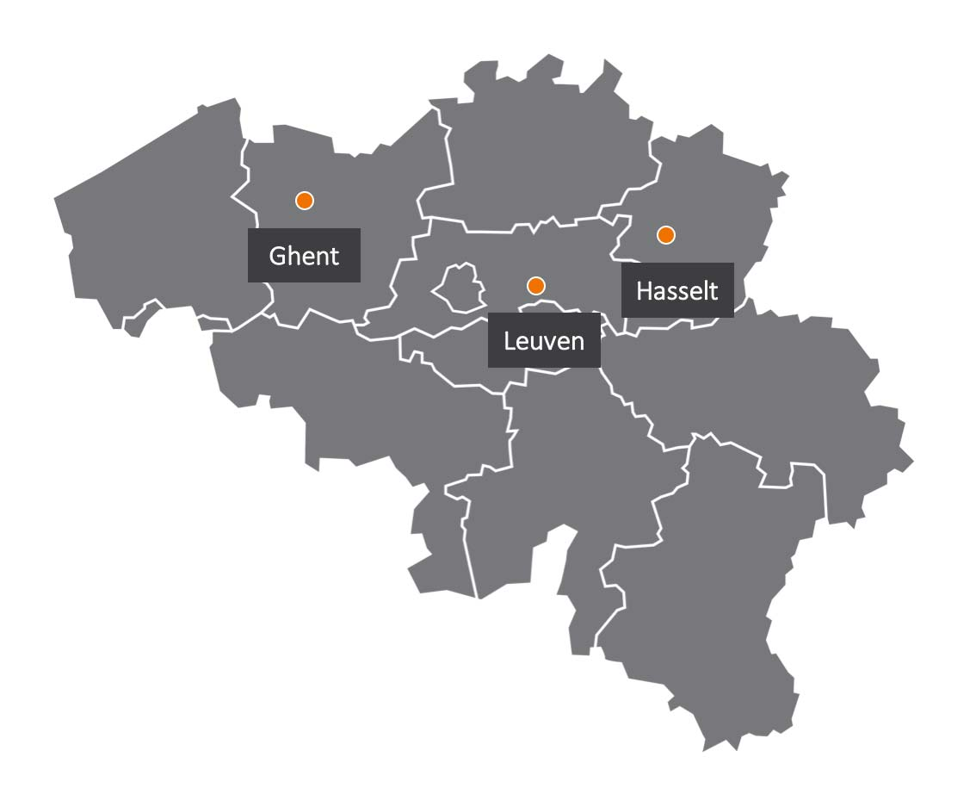
Let’s get to know AE
Business & ICT consultancy
Established in 1999
10 – 15% yearly growth
360 employers
Great Place to work
Offices in:
Leuven
Gent
Hasselt
Antwerpen
Groot-Bijgaarden
Antwerpen

Slide 8


Slide 9




Let’s get to know AE
1999 Application Engineers
2005 Architects for business & ICT
2021 AE - Adapt and Enable

Slide 10


Slide 11

Let’s get to know AE
Business & ICT consultancy:
Helping customers achieve their strategic goals in the digital world by listening to them, understanding their challenges and building the technology needed to do so.
AE Studio:
Building own products to help clients define the right strategy and to provide quality support and long-term services.

Slide 12


Slide 13
Let’s get to know AE
Continuous improvement
Commitment
AE culture
People growth
Balance

Slide 14


Slide 15
Time series introduction

Slide 16

Time series introduction – business cases
Economics
Consumer price index
Unemployment
Social science
Population
Epidemiology
Covid figures
Medical
Brain monitoring EEG
Heart rate monitoring ECG
Physical science
Rainfall
Temperature
…
Notes:
Time series data is data that is collected at different points in time. This is opposed to cross-sectional data which observes individuals, companies, etc. at a single point in time.
Because data points in time series are collected at adjacent time periods there is potential for correlation between observations. This is one of the features that distinguishes time series data from cross-sectional data.
Multiple business domains could be analyzed with the help of time series

Slide 17
Time series introduction
What makes time series special - different?
Successive observations are usually not independent
! Analysis must consider the time order
Future values may be predicted from past observations!
Have characteristics like seasonality and trend
Require retraining on a regular basis
Notes:
A time series is simply a series of data points ordered in time
Often:
Time = independent variable
Goal = make a forecast for the future
Examples:
Daily/weekly/monthly sales of houses ….
Electricity usage over time of one househould (cfr digital meter) or a region, ….
Daily temperature / rainfall / …
Daily number of covid deaths / hospitalisations / infections / …
The water level …
Daily time of sunrise
Number of people on a bus / train
Sensor data
…

Slide 18
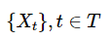
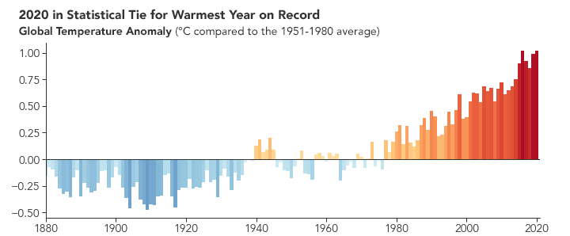

Time series introduction - terminology
A ‘Time Series’ is a collection of observations indexed by time. The observations each occur at some time t, where t belongs to the set of allowed times, T.
Source NASA
Notes:
A time series is simply a series of data points ordered in time
Often:
Time = independent variable
Goal = make a forecast for the future
Examples:
Daily/weekly/monthly sales of houses ….
Electricity usage over time of one househould (cfr digital meter) or a region, ….
Daily temperature / rainfall / …
Daily number of covid deaths / hospitalisations / infections / …
The water level …
Daily time of sunrise
Number of people on a bus / train
Sensor data
…

Slide 19
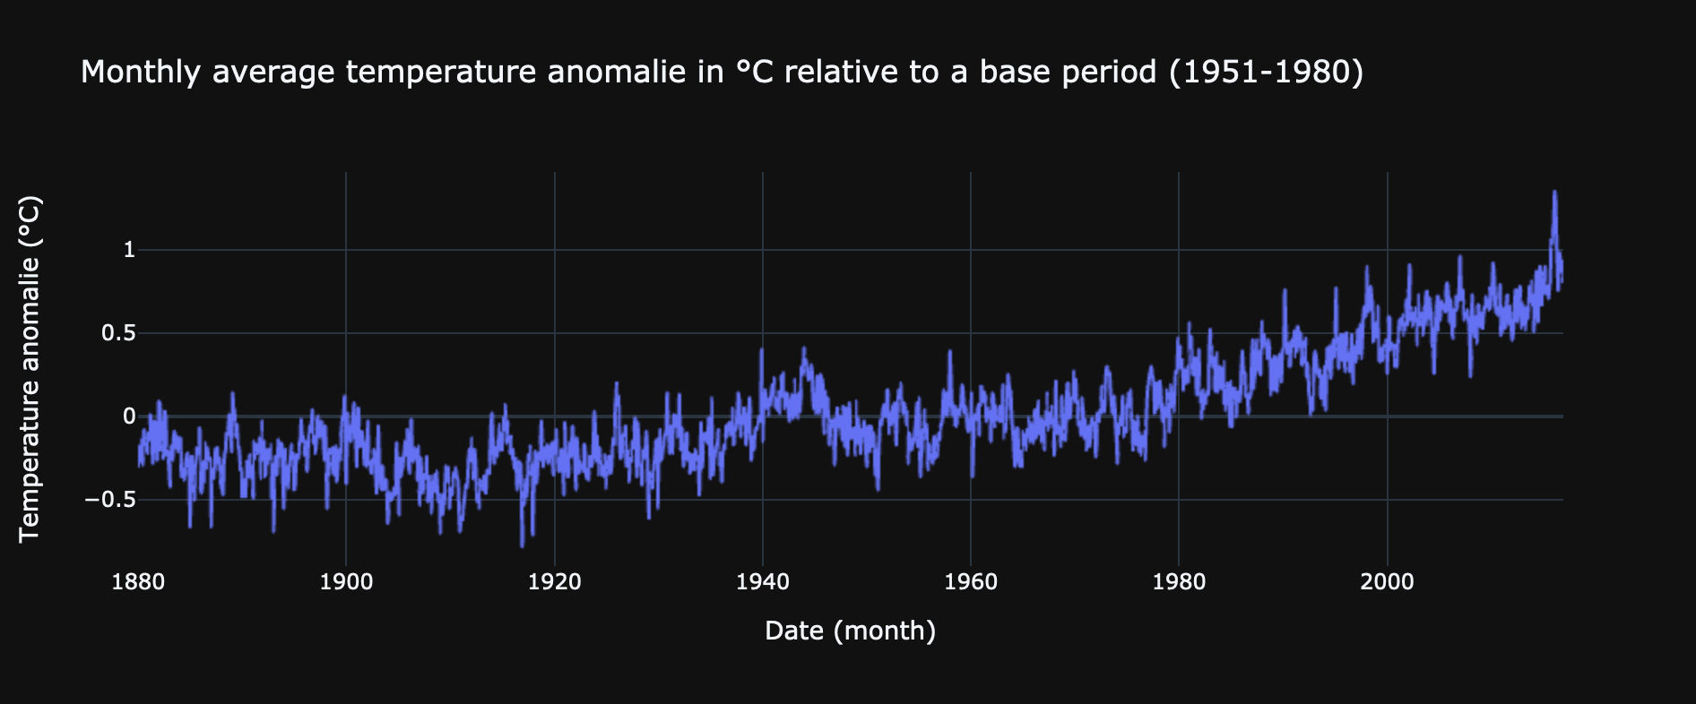
Time series introduction - terminology
Discrete vs continuous
A discrete time series consists of data points at specific times. Points are separated by time intervals that can be equally or unequally spaced.
A continous measurement = temperature
Discrete time = month
Discrete time series
Notes:
Discrete = when observations are taken only at specific times
Continuous = when observations are made continuously through time

Slide 20
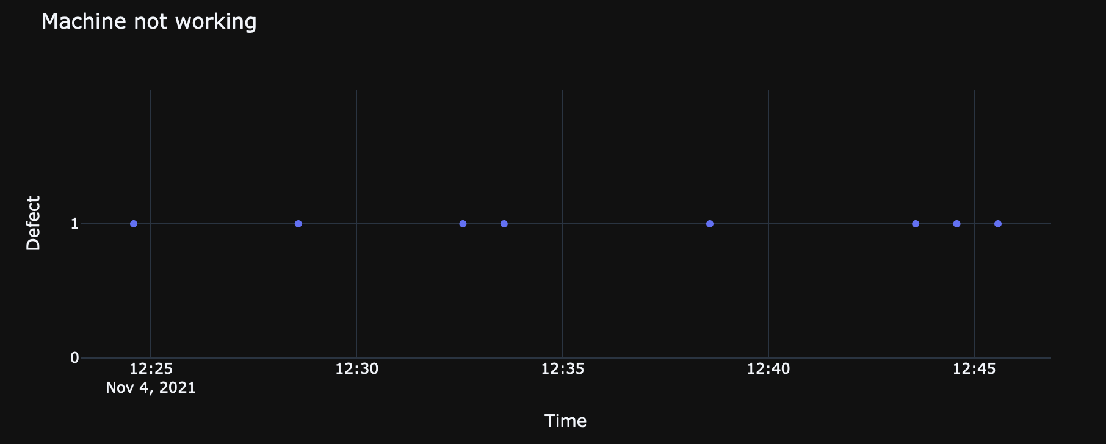
Time series introduction - terminology
Discrete vs continuous
A discrete time series consists of data points at specific times. Points are separated by time intervals that can be equally or unequally spaced.
A continuous time series has a data value corresponding to every moment in time.
A binary measurement (0 = working, 1 = not working)
Continuous time
Continous time series
Notes:
Discrete = when observations are taken only at specific times
Continuous = when observations are made continuously through time

Slide 21
Time series introduction - terminology
Discrete vs continuous
A discrete time series consists of data points at specific times. Points are separated by time intervals that can be equally or unequally spaced.
A continuous time series has a data value corresponding to every moment in time.
Often, a continuous time series is discretized.
Sampled E.g. a continuous earthquake vibration signal sampled at one second interval
Aggregated E.g. monthly temperature
Notes:
Discrete = when observations are taken only at specific times
Continuous = when observations are made continuously through time
Sampled = sample (take) observations at specific points in time – at equal intervales of time
Aggregated = aggregate the observations over equal intervals

Slide 22
Time series introduction - terminology
Discrete vs continuous
A discrete time series consists of data points at specific times. Points are separated by time intervals that can be equally or unequally spaced.
A continuous time series has a data value corresponding to every moment in time.
Often, a continuous time series is discretized.
Univariate vs multivariate
Univariate: one single variable, observation over a time period
Multivariate: two or more variables are varying over a time period
Focus: Discrete, univariate timeseries
Notes:
Discrete = when observations are taken only at specific times
Continuous = when observations are made continuously through time

Slide 23
Time series introduction - terminology
Lag
is a fixed amount of passing time the 1st lag value = value shifted back one time period the k^{th} lag value = value shifted back k time points e.g. in timeseries y_{t1}, y_{t2}, y_{t3}, ….. : y_{t1} is the first order lag of y_{t2}
Cross-correlation
is a measure of similarity of two different time series as a function of the displacement of one relative to the other. For example: “Are two audio signals in phase?”
Auto-correlation
Measures the linear relationship between lagged values of a time series (= cross-correlation with itself). It aims, for example, to detect repeating patterns or seasonality. For example: “Does the current week’s data highly correlate with that of the previous week?”

Slide 24
Time series introduction - patterns
Trend
A trend exists when there is a long-term increase or decrease in the data. It does not have to be linear.
Seasonal:
A seasonal pattern occurs when a time-series is affected by seasonal factors (e.g day of the week, month of the year, season, …).
Cycle:
A cycle occurs when the data exhibit rises and falls that are not of a fixed frequency. (Often due to economic conditions)
Frequency: the number of observations before a pattern repeats.
Notes:
https://otexts.com/fpp2/graphics.html
Seasonality refers to periodic fluctuations
! Seasonal ⬄ cyclic
Not a fixed frequency: cyclic
If frequency is unchanging and associated with a calendar aspect: seasonal

Slide 25
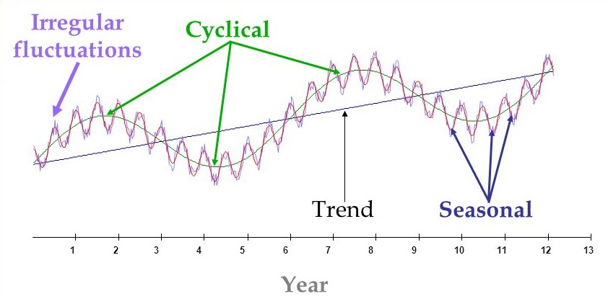
Time series introduction - patterns

Slide 26
Time series decomposition

Slide 27
Time series decomposition – components
Split a timeseries into several components
Each component represent pattern category
Helps to understand & model
Split in three components
T – trend & cycle
S – seasonal
R – remainder
Notes:
Time series data can exhibit a variety of patterns, and it is often helpful to split a time series into several components, each representing an underlying pattern category.

Slide 28
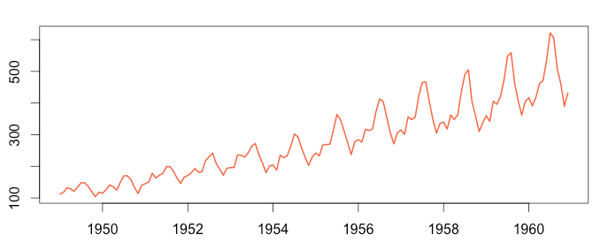
Time series decomposition - Seasonality
Seasonality
A repeating pattern related to a calendar period. It could be weekly, yearly or at some other fixed calendar interval. Seasonality represents a repeated and clear change in a time series.

Slide 29
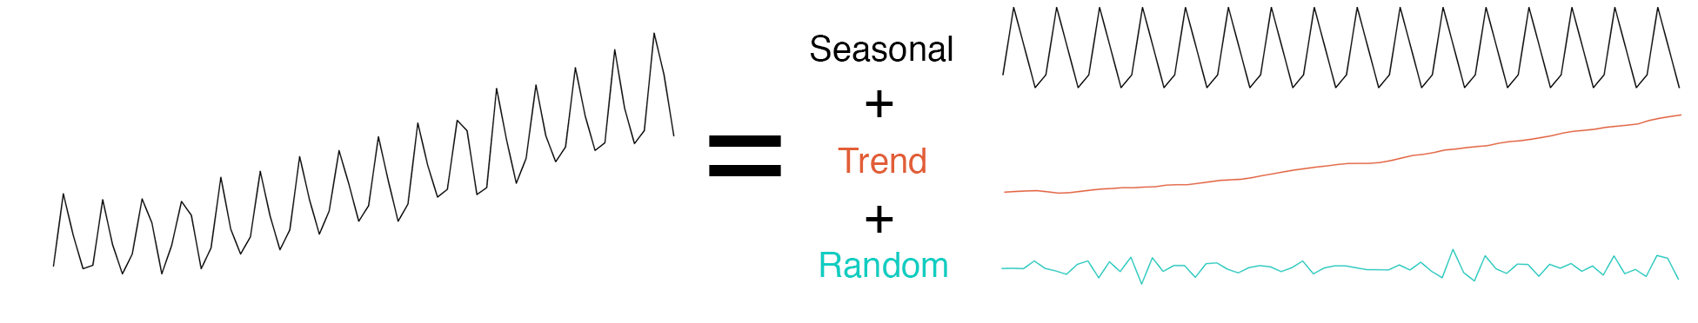
Time series decomposition - components
Decomposition
Notes:
https://machinelearningmastery.com/time-series-seasonality-with-python/
https://anomaly.io/seasonal-trend-decomposition-in-r/index.html
-> practical use case?

Slide 30
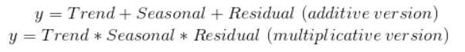
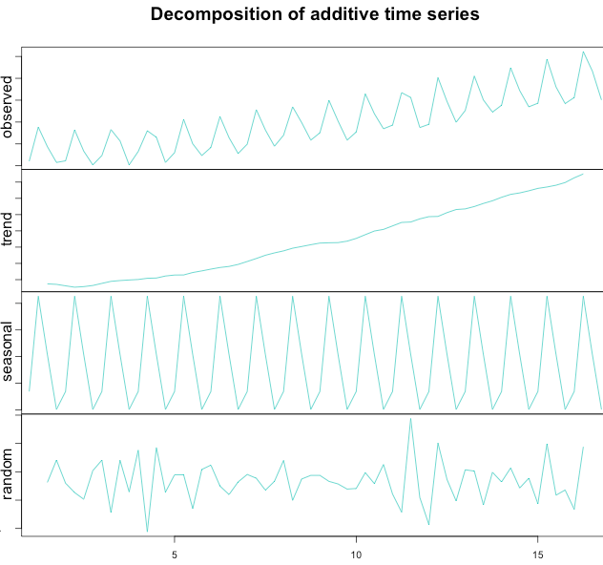
Time series decomposition
Additive
Y_{t} = T_{t} + S_{t} + R_{t} (y_{t} = observation at period t)
Magnitude of fluctuations does not vary, Variation looks constant; it doesn’t change when the time series value increases.
Source towardsdatascience
Notes:
Time series data can exhibit a variety of patterns, and it is often helpful to split a time series into several components, each representing an underlying pattern category.
If we assume an additive decomposition, then we can write yt=St+Tt+Rt, where yt is the data, St is the seasonal component, Tt is the trend-cycle component, and Rt is the remainder component, all at period t. Alternatively, a multiplicative decomposition would be written as yt=St×Tt×Rt.
The additive decomposition is the most appropriate if the magnitude of the seasonal fluctuations, or the variation around the trend-cycle, does not vary with the level of the time series. When the variation in the seasonal pattern, or the variation around the trend-cycle, appears to be proportional to the level of the time series, then a multiplicative decomposition is more appropriate. Multiplicative decompositions are common with economic time series.

Slide 31
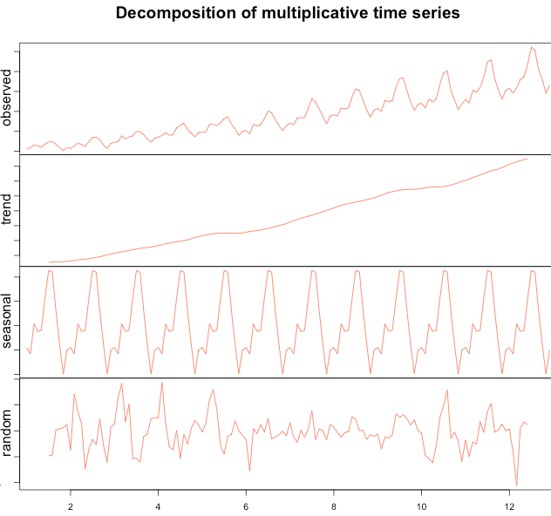
Time series decomposition
Multiplicative
Y_{t} = T_{t} x S_{t} x R_{t} (y_{t} = observation at period t)
Variation in seasonality / around trend appears to be proportional as timeseries increases
Source towardsdatascience
Notes:
Time series data can exhibit a variety of patterns, and it is often helpful to split a time series into several components, each representing an underlying pattern category.
If we assume an additive decomposition, then we can write yt=St+Tt+Rt, where yt is the data, St is the seasonal component, Tt is the trend-cycle component, and Rt is the remainder component, all at period t. Alternatively, a multiplicative decomposition would be written as yt=St×Tt×Rt.
The additive decomposition is the most appropriate if the magnitude of the seasonal fluctuations, or the variation around the trend-cycle, does not vary with the level of the time series. When the variation in the seasonal pattern, or the variation around the trend-cycle, appears to be proportional to the level of the time series, then a multiplicative decomposition is more appropriate. Multiplicative decompositions are common with economic time series.

Slide 32
Time series introduction - Stationarity
Stationary time series
A timeseries whose properties do not depend on the time at which the series is observed
No predictable patterns in long term
A timeseries with seasonality and/or trend = not stationary
White noise (e.g. remainder), random walks = stationary
Seasonal stationary: the seasonal component has been
Dickey-Fuller test (ADF test)
a common statistical test used to test whether a given time series is stationary or not
Differencing
method to make a timeseries stationary
first degree: y_{t} – y_{t-1}
Notes:
https://anomaly.io/seasonal-trend-decomposition-in-r/index.html
https://medium.com/@cmukesh8688/why-is-augmented-dickey-fuller-test-adf-test-so-important-in-time-series-analysis-6fc97c6be2f0
A stationary time series is one whose statistical properties do not depend on the time at which the series is observed.¹⁵ Thus, time series with trends, or with seasonality, are not stationary — the trend and seasonality will affect the value of the time series at different times. On the other hand, a white noise series is stationary — it does not matter when you observe it, it should look much the same at any point in time.
Some cases can be confusing — a time series with cyclic behaviour (but with no trend or seasonality) is stationary. This is because the cycles are not of a fixed length, so before we observe the series we cannot be sure where the peaks and troughs of the cycles will be.
In general, a stationary time series will have no predictable patterns in the long-term. Time plots will show the series to be roughly horizontal (although some cyclic behaviour is possible), with constant variance.

Slide 33
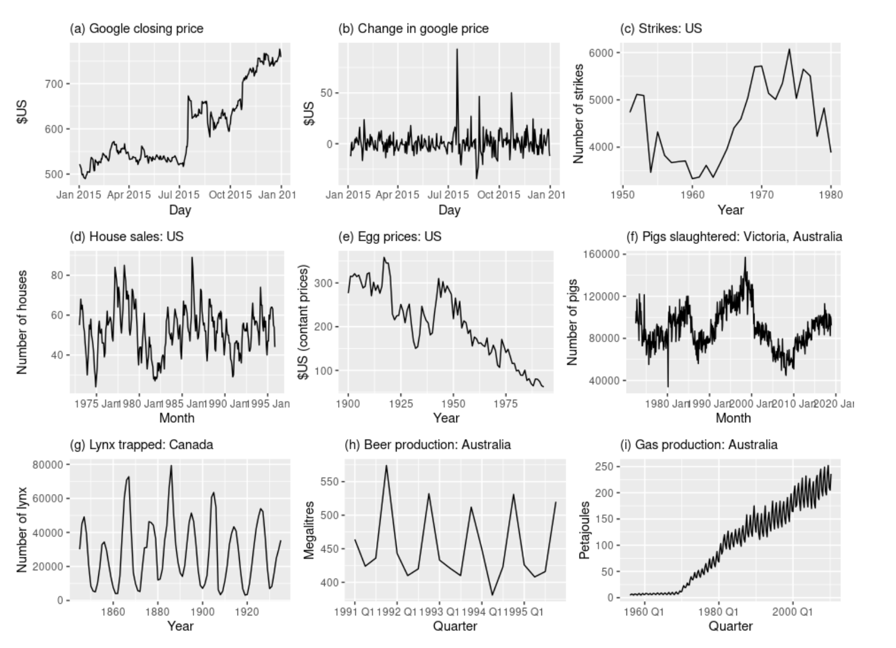
Time series introduction - Stationarity
Which are stationary?
Notes:
https://otexts.com/fpp3/stationarity.html
Clear seasonality: d, h, i
Clear trend: a, c, e, I
! g has aperiodic cycles – on the long term not predictable

Slide 34
Time series visualisation

Slide 35
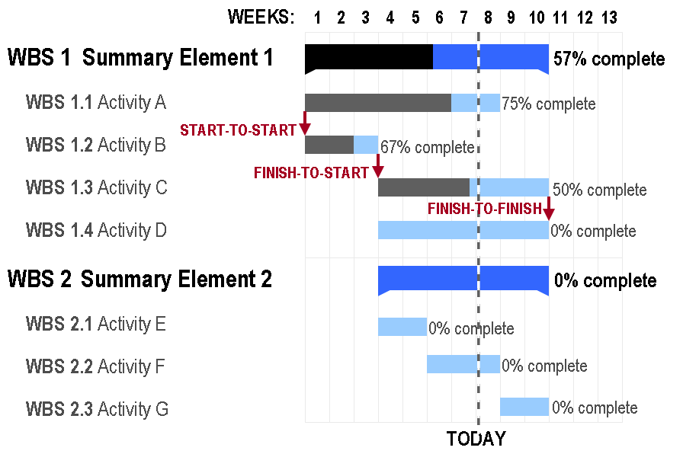
Time series visualization
Line graph
Bar chart
Heatmap
Stream graph
Gantt chart
…
Notes:
https://towardsdatascience.com/a-complete-guide-to-time-series-data-visualization-in-python-da0ddd2cfb01

Slide 36
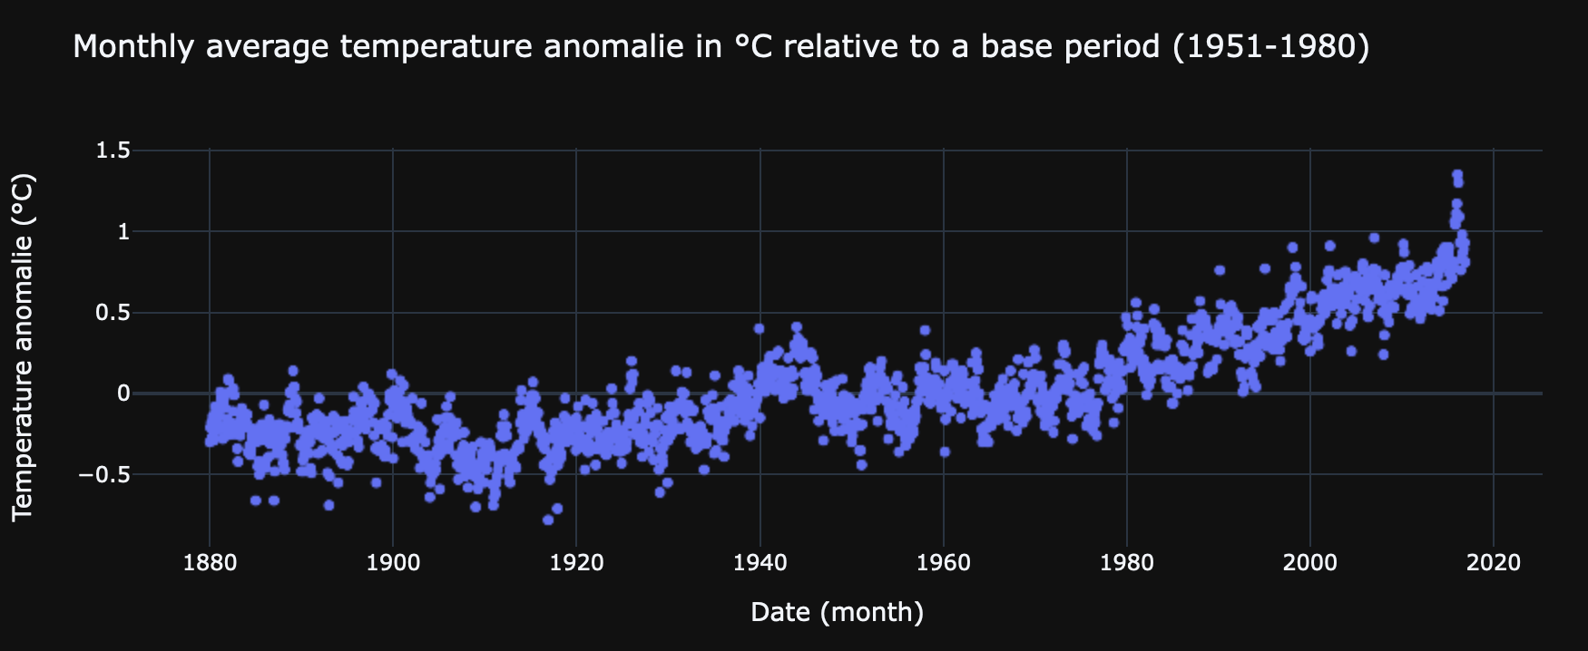
Time series visualisation – scatter plot
Clear trend
Variation looks constant
? Seasonality unclear

Slide 37
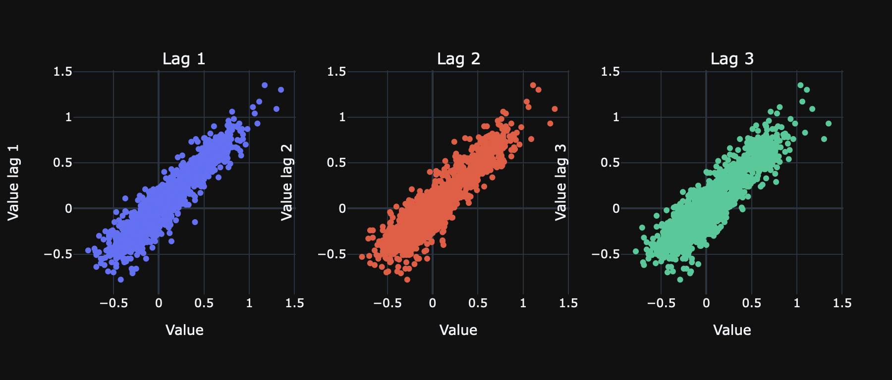
Time series visualisation – lag plot

Slide 38
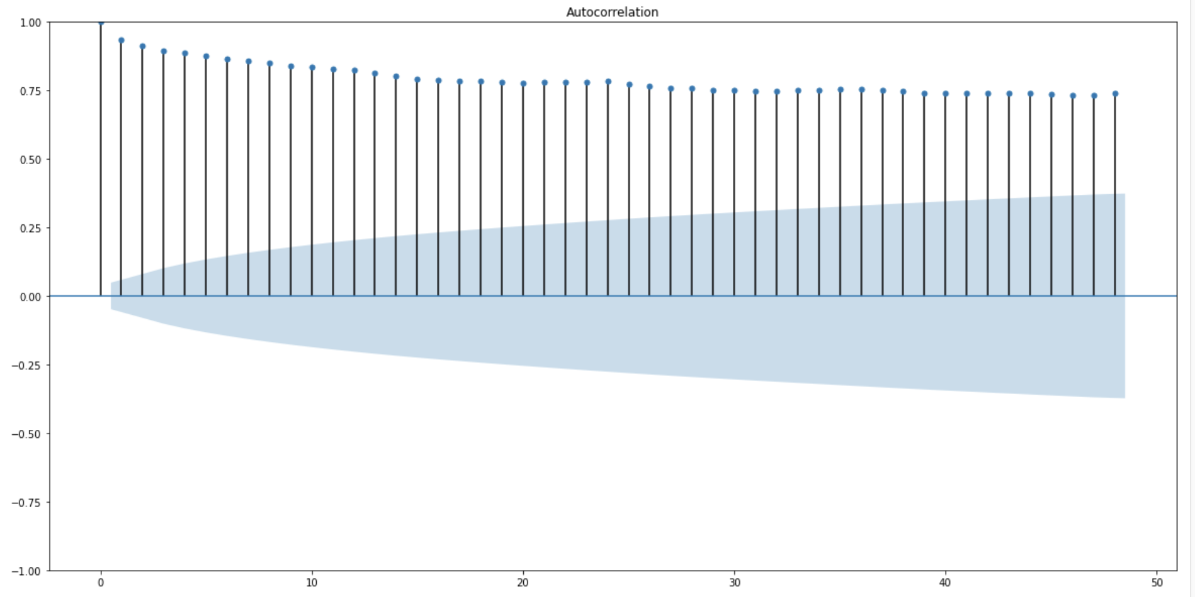
Time series visualisation – ACF plot
Highly dependent observations
No clear seasonal patterns

Slide 39
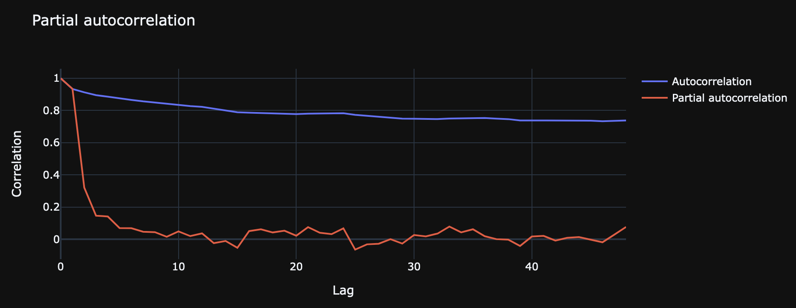
Time series visualisation – (P)ACF plot

Slide 40
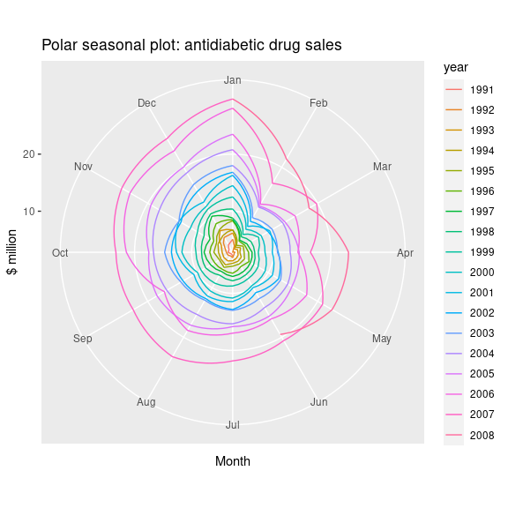
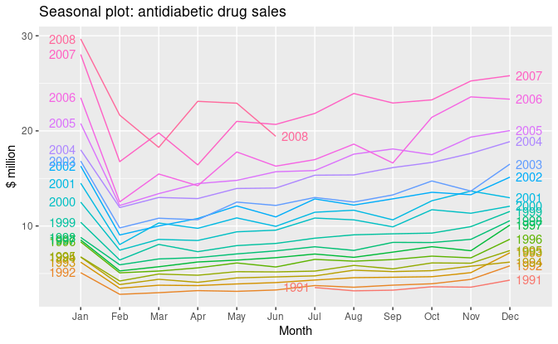
Time series visualization – tips & tricks
Source otexts
Notes:
https://otexts.com/fpp2/seasonal-plots.html
Wat zijn de seasonal effects/ welke duidelijk? covid oversterfte vb

Slide 41
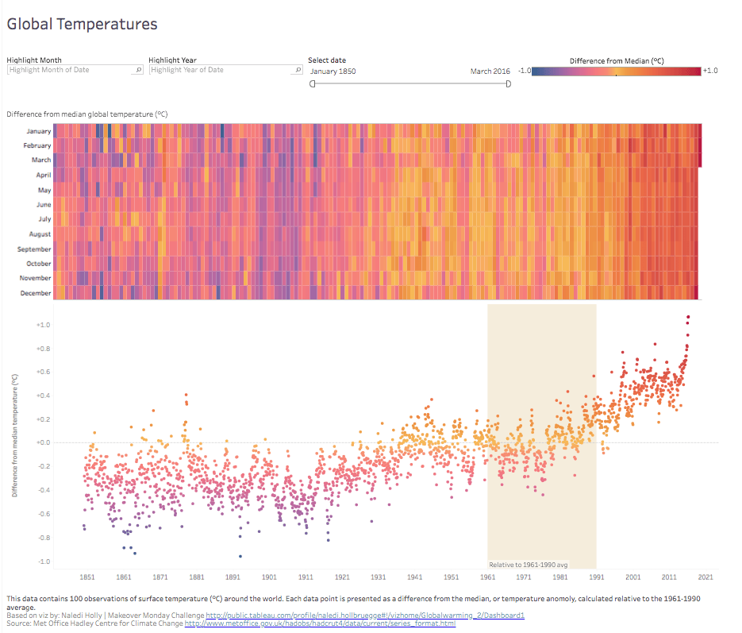
Time series visualization – tips & tricks
Who is my audience?
What questions do they have?
What answers am I finding for them?
What am I trying to say?
What other questions will my visualization inspire or what conversations may result?
Business oriented focus!
-> keep it simple!
Source Tableau
Notes:
https://www.digitalocean.com/community/tutorials/a-guide-to-time-series-visualization-with-python-3
https://www.kaggle.com/subinium/all-you-need-is-time-series-visualization-20
https://www.tableau.com/learn/articles/data-visualization-tips

Slide 42
Time series prediction

Slide 43
Time series introduction – Machine learning
Classification:
Identifies and assigns categories to the data.
Forecasting:
Predicts future data. This type is based on historical trends. It uses the historical data as a model for future data, predicting scenarios that could happen along future plot points.
Segmentation:
Splits the data into segments to show the underlying properties of the source information.
Anomaly detection:
“An observation which deviates so much from other observations as to arouse suspicions that it was generated by a different mechanism.”
FOCUS
Notes:
https://neptune.ai/blog/anomaly-detection-in-time-series
-> python based examples

Slide 44
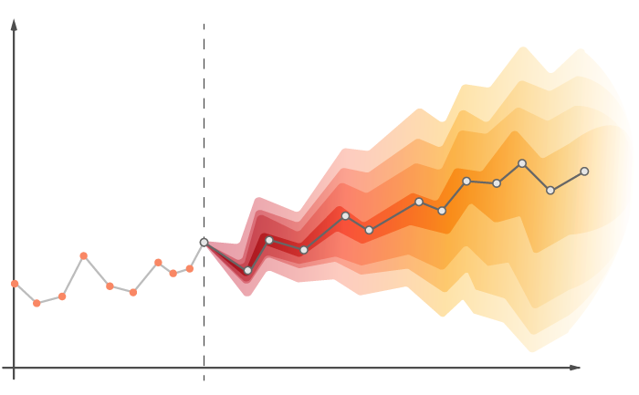
Time series introduction - forecasting
Naïve, SNaïve
Seasonal decomposition (+ any model)
Exponential smoothing
ARIMA, SARIMA
GARCH
Dynamic linear models
TBATS
Prophet
NNETAR
LSTM
…
Source Medium
Notes:
https://towardsdatascience.com/an-overview-of-time-series-forecasting-models-a2fa7a358fcb

Slide 45
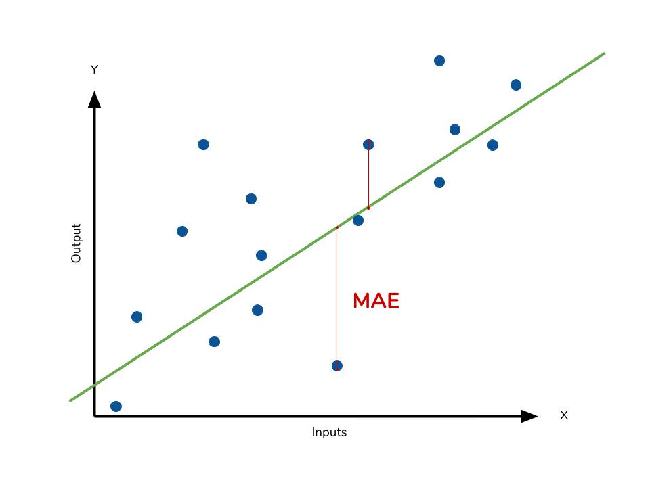
Time series introduction - forecasting
Performance
MAE: Mean Absolute Error
Takes the sum of the absolute difference between actual and forecasted values and averages them. It is less sensitive to the occasional very large error because it does not square the errors in the calculation.
RMSE: Root Mean Squared Error
Takes the root of the average of the squared differences between actual and forecasted values (sample standard deviation).
Is more sensitive to large errors.
Notes:
https://towardsdatascience.com/measures-performance-for-a-time-series-model-ets-or-arima-18b0a3e91e83
Vb MAE / gemiddelde grote -> procentuele analyse vb lijn
Forecast -> business

Slide 46
Time series introduction - forecasting
Performance
MAE and RMSE cannot be used to compare models / between data sets
Instead use
RMSE/mean observations or MAE/mean observations
AIC / BIC – information criteria to compare the performance of different models
Lower values, imply better forecast (comparison between algorithms)
Metrics introduced are ‘standard’ performance metrics
! A performance metric should always take context (business) into consideration.
Notes:
https://towardsdatascience.com/measures-performance-for-a-time-series-model-ets-or-arima-18b0a3e91e83
Vb MAE / gemiddelde grote -> procentuele analyse vb lijn
Forecast -> business

Slide 47
Time series introduction - forecasting
Moving average
A moving average model uses past forecast errors in a regression-like model.
Each value of y_{t} can be thought of as a weighted moving average of the past few forecast errors.
Autoregression
Forecast the variable of interest using a linear combination of past values of the variable. It is a regression of the variable against itself. Timeseries should be stationairy!
q: is the order
c: is a constant
epsilon: noise
p: is the order
c: is a constant
epsilon: noise
Notes:
https://towardsdatascience.com/the-complete-guide-to-time-series-analysis-and-forecasting-70d476bfe775
https://towardsdatascience.com/time-series-forecasting-with-autoregressive-processes-ba629717401

Slide 48
Time series introduction - forecasting
ARIMA model
AutoRegressive Integraded Moving Average model
AR (autoregression) + I (integrated) + MA (moving average)
It combines both Autoregression (AR) and Moving Average (MA) models as well as a differencing pre-processing step of the sequence to make the sequence stationary, called integration (I).
Parameters
p = number of lags
d = number of differencing steps
q = number of lagged errors
With y’ is the differenced series
Notes:
Basically, a regression of the time series onto itself. Here, we assume that the current value depends on its previous values with some lag.

Slide 49
Time series introduction - forecasting
Prophet
Open source library, released by Facebook’s core datascience team
Forecasts for univariate times series
Based on decomposing a timeseries
Uses generalized lineair model techniques
Non-linear trends are fit with yearly, weekly, and daily seasonality, plus holiday effects.
It works best with time series that have strong seasonal effects and several seasons of historical data.
It is robust to missing data and shifts in the trend, and typically handles outliers well
Notes:
https://facebook.github.io/prophet/docs/quick_start.html
The Prophet library is an open-source library designed for making forecasts for univariate time series datasets. It is easy to use and designed to automatically find a good set of hyperparameters for the model in an effort to make skillful forecasts for data with trends and seasonal structure by default.

Slide 50
Let’s try it out!

Slide 51
Let’s try it out!
Prophet
https://facebook.github.io/prophet/docs/quick_start.html
Darts
https://github.com/unit8co/darts
Cesium
https://github.com/cesium-ml/cesium
Matplotlib/ Seaborn for visualization
https://matplotlib.org/
https://seaborn.pydata.org/
Statsmodels
https://www.statsmodels.org/stable/index.html
Notes:
https://machinelearningmastery.com/time-series-forecasting-with-prophet-in-python/
https://analyticsindiamag.com/top-10-python-tools-for-time-series-analysis/
https://github.com/cesium-ml/cesium

Slide 52
www.ae.be inspire@ae.be +32 16 39 30 60
Interleuvenlaan 27b
3001 Heverlee

